Slide 1
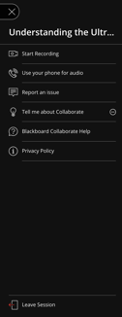
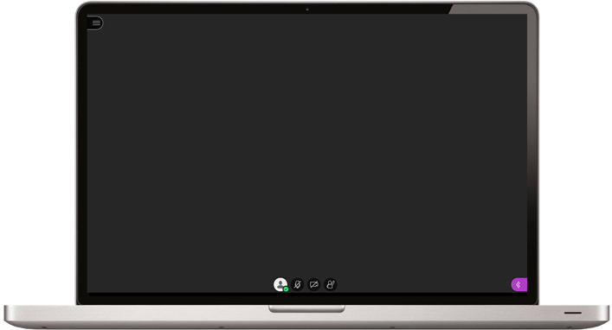
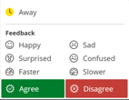
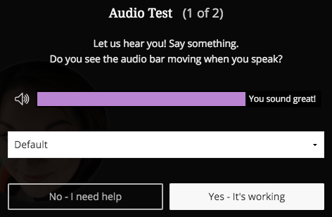
Welcome to Blackboard Collaborate.
The session will begin shortly.
Want to talk using built-in audio? Click the mic button and wait until it is animated and green.
Open to access session options
Open to access:
Chat, participant list, share content, my settings (for dial-in)
Need to troubleshoot your audio? Open the Collaborate Panel > My Settings > Audio and Video Settings > Set Up your Camera and Microphone. Select your preferred device and watch for the moving meter bar.
Click silhouette to add a picture / indicate status. Turn on audio or video. Raise your hand
To turn pop-up notifications off – select the 'gear' icon in bottom right corner, and scroll down to the Notification Settings section, uncheck 'Collaborate pop-up notification'
Collaborate support: https://elearn.southampton.ac.uk/collaborate

Slide 2
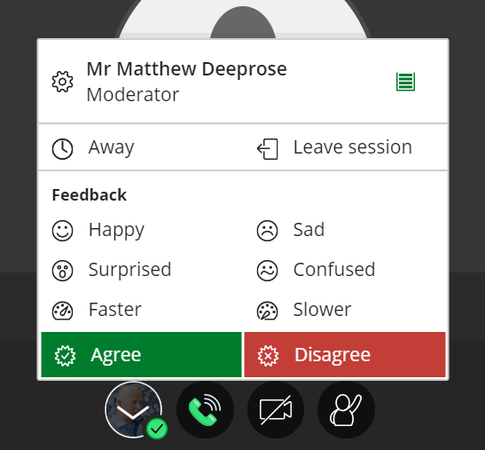
You may click on your avatar and use these controls to express sentiment.
[Everyone will see]

